Slide 1

Senior
Night

Slide 2
Senior Night
CRANE HIGH SCHOOL
CLASS OF 2016
MICHELLE RABINOWITZ
7-12 COUNSELOR
417-723-5300 EXT 1400
RABIM@CRANE.K12.MO.US
Facebook: Crane High School Counselor Page
Email: If you would like receive newsletters by email, email me
Remind101: Text @crane16 to 81010
to be signed up for text reminders
Notes:
1. Welcome, introduce self
2. Purpose to answer some of the same questions we get frequently in our office (hope not to insult anyone, tried to be thorough)
Please join FB or Twitter. Posts of important information, upcoming tests, college rep visits, scholarships, etc.

Slide 3
Senior Items- senior calendar
Roses at graduation
Songs at graduation
Graduation speaker
Pictures needed
3 pictures for slideshow
Baby picture for yearbook
all others give to Mrs. Lumpkin for Prom slideshow
Jostens order- next slide

Slide 4
Jostens Senior Items
First things first.
-Pay for your cap and gown first. If you are ONLY buying the cap and gown, and nothing else, it is $30. That is due by Friday, November 20th.
- Make sure you are buying within your budget, it is very easy to buy $400 worth of senior items quickly.
- Consider other sources

Slide 5

We can do this…TOGETHER
SENIOR BACCALAUREATE
TBD, 2016
SENIOR SCHOLARSHIP/AWARDS NIGHT
MONDAY, MAY 9, 2016 7PM, BY INVITATION
GRADUATION
SUNDAY, MAY 15, 2016 3PM, NEW GYM
(255 DAYS FROM TODAY!!!)
Notes:
‹#›

Slide 6



What Do I Do Now?
College
-Two year college
-Four year college
-Technical school
*Does the college you want to attend
have the program you want to study?
Military
Work
Notes:
1. Important process—can create pressure and stress on students

Slide 7
Self Knowledge
What are my goals?
What are my abilities?
What are my interests?
What are my values?
What are my skills?
Notes:
1. Lots of online resources for self discovery—what are you good at?, what doesn’t feel like work?, great to say your love your career

Slide 8
Calm the Frenzy
Work to figure out a good fit for you after graduation
Include your parents/important adults
Build your student up even more during this time
Be more helpful and understanding than ever before
Everyone will have high emotions
Notes:
1. I’ve already seen a number of students in my office stressed and worried about that question, “What are you going to do?”

Slide 9


Notes:
‹#›

Slide 10

Required Credits for Graduation
English 4.0
Math 3.0
Science 3.0
Social Studies 3.0
Health 0.5
Personal Finance 0.5
PE 1.0
Practical Art 1.0
Fine Arts 1.0
Electives 9.0
26 state credits minimum
Notes:
‹#›

Slide 11
Transcript, GPA, class rank
“Unofficial” transcripts can be requested/received (general application info.) *Stop by Mrs. Rabi’s office for a copy- a copy was mailed out this week
Official Transcripts (stamped) require a transcript request, stop by Mrs. Rabi’s office to sign up
*Give a week’s notice before your deadline
-can mail or sent “sealed” with student
Transcripts, rank, and GPA are confidential
Review transcript information to make sure it is correct– see your counselor if you think any information is not accurate
Notes:
See Handout for transcript request
This summer I checked transcripts. I have spoken to students who are in a tough spot. Review grades each quarter, especially after 1st semester—more conversations if needed

Slide 12
Transcripts
Final HS transcripts mailed (in May after final grades) to the institution you report to us at graduation practice
Missing paperwork—DON’T PANIC
-May not be in the system yet—follow up with call to Admissions office
FERPA laws- CHS cannot obtain ANY college transcripts
-Check college website for request forms online
-Wait until final grades are posted, YOU must request it
Notes:
‹#›

Slide 13

College Entrance Exams
ACT - www.actstudent.org/start
ACT Prep class- 6th hour
LOTS of free study materials online or Mrs. Rabinowitz has materials.
Crane HS has purchased John Baylor Test Prep for all students- videos and workbook
Notes:
See Handouts
Differences in ACT vs SAT
-SAT Mandatory writing, more vocab focus, broken up into more sections (10 of CR, MA, Rdg), look at score in each
-ACT interest inventory component, no guess penalty, SC section, harder MA concepts but questions are more straighforward, 4 sections SC, MA, Rdg, Eng, look at composite
ACT used by most universities around the mid-west—SAT little bit different form in that ????
See Handout—ACT test dates and school codes (generally Cottey College only)
See Handout-ACT Prep (sign up now)

Slide 14
College Athletics- DI, DII, DIII
Student must complete NCAA Clearinghouse application at: www.ncaaclearinghouse.org
Pay the fee- this year- $75, can use fee waiver**
Have ACT/SAT score sent directly- code 9999
Have Mrs. Rabi send your transcript
LOTS of rules—may require an appointment with student, parent, Mrs. Rabinowitz
See Handout
Notes:
I have been given names from Athletic Director through coaches. I have briefly checked to make sure course requirements have been met—different for Div I and Div II and III schools
Please make note on bottom of Parent Info sheet if you have NCAA questions or would like me to contact you about this

Slide 15
College Athletics- NAIA, NJCA
NAIA- cost increased to $75, can use a fee waiver, register! ($100 after graduation)
http://www.playnaia.org/index.php
Must meet 2 of the 3 requirements
18 on ACT- send score, use code 9876
2.0 GPA
be in top 50% of graduating class
http://mrsrabi.weebly.com/colleges.html Scroll down for the links
NJCA- eligibility is up to the college, no clearinghouse to register with
Notes:
I have been given names from Athletic Director through coaches. I have briefly checked to make sure course requirements have been met—different for Div I and Div II and III schools
Please make note on bottom of Parent Info sheet if you have NCAA questions or would like me to contact you about this

Slide 16
Sending Scores
Students responsible for sending official scores to each university/NCAA/NAIA to which they apply
Student’s best score used—send all and send early
Not having scores holds up the process
*biggest factor in not being eligible is not meeting deadlines with scores and other paperwork
MEET DEADLINES
Notes:
‹#›

Slide 17
Other Options: Career Trade School
4-year college may not be necessary for career success
unprepared for college–academically, emotionally, and financially
$$$$$s are spent on 4 year universities - students often struggle to pay back loans without a job (may be in school longer than 4 years)
Good financial aid- example: MTI take federal funds
Notes:
‹#›

Slide 18
Other Options: Trade Schools
Many job options in skilled trades—these jobs may be obtained faster and easier than jobs from a four-year college, if earning the right credentials
Electrician, Plumber, Carpenter, Master Builder, Mechanic, Auto Body Technician, Mason, Drywaller, Heating and Refrigeration Technician

Slide 19
5 Reasons to Attend Trade School
Learn a specific career trade instead of focusing on a broad range of academics
Smaller classrooms for teacher-student interaction
Hands-on training (perfect for hands-on learners)
No longer than 2-3 years and as short as 6-10 weeks on average
Tuition and expenses combined are less than a four-year college, even though it may seem more expensive at first
Notes:
‹#›

Slide 20
Other Options: Military
Decision is a very serious one that should not be made lightly
Provides Career and Training opportunities (Infantry, operating high tech equipment, medical technician)
Encourage your student but don’t sign anything unless parent is there
The military can provide many paths: college before, college during, or college after service
Notes:
‹#›

Slide 21
Military
With good grades, consider applying to the ROTC program as entering freshman
College ROTC programs offer many scholarships that pay for students’ college education in full
ROTC graduates receive higher pay, more responsibility, and better benefits than enlistees without a degree
Questions? Contact a recruiter for a personal visit
Notes:
‹#›

Slide 22

College
Finding the right fit

Slide 23

Factors Colleges Consider
Academic Review:
  ACT Test scores
  Academic record- GPA and class rank
  Extracurricular activities and community service
  Recommendations
  Children of alumni?
  Work experience and leadership
  Interviews
  Correspondence
Notes:
‹#›

Slide 24
The Right Fit
Location
Size
Major
Special programs
Campus activities
Cost
Work opportunities
Housing
Notes:
‹#›

Slide 25
Applications
Each application sent to a different school requires an application fee and separate transcript
Individual Campus websites – Admissions link
Universities prefer that you apply online instead of a paper copy
*COPY and SAVE all information sent
Fee Waivers - free or reduced lunches
Notes:
‹#›

Slide 26
Counselor Forms
Sign up on Transcript Request on the clipboard in my office
Make sure you have filled out and signed all the forms
Mrs. Rabi will complete form or letter and mail everything with the transcript for you
Allow up to two weeks for this process. I want to write the best possible letter but perfection takes time! ☺
Notes:
‹#›

Slide 27
Your Involvement Resume
Be organized and consistent
Sort items by grade level (most recent first)
Sort items by category
(sports, service, leadership, etc.)
Log community service hours
Avoid repetition
Use not only for college apps but for teacher and counselor use on rec. letters
There is a blank copy online on my website, under the scholarship section (Handout in your packet)
Notes:
‹#›

Slide 28
Teacher Recommendations
Can the teacher add information about your learning that is not in the application?
Hurried letter will not be as helpful as well thought out and complete recommendation--give lots of time
(Sometimes helpful to provide resume)
Give teachers a self addressed stamped
envelope of where to send the letters
Follow up with thank you letter
Notes:
‹#›

Slide 29

College Essays
IMPORTANCE of a quality essay:
  Displays written skills
  Shows that you are serious about application
  Allows for glimpses of your
  personality
  May share obstacles or special talents
  Leadership or history of work ethic
  Read, re-read, ask an English teacher or your counselor to proofread
  Make yours stand out
Notes:
‹#›

Slide 30
Getting Admitted
Make several contacts with the school(s) of choice
*The more email admissions, calls, visits--the more interest you show
Visit the school, dress appropriately, have questions ready
-Visit more than once if possible
-(2 visits senior year excused—with form and proof)
Proofread everything you send to the college. Paperwork is all the admissions office knows you by at this point.
Set a timetable and follow as closely as possible.
Use long weekends and holidays to finish applications.
Once you have submitted all of your applications, you
should feel a huge sense of relief – celebrate!!!
Notes:
1. See Handout College Visit—turn into Mrs. Rabi will keep the paper until student returns a letter from college verifying visit then absence is excused

Slide 31

Prepare and Finish Early
Begin applying now
Many utilize the same “type” of questions and essays—save and keep copies
Create a file for each college you apply to--keep copies of every letter and application that you submit along with any information you are sent
(portfolios available on the table for your use)
If essays or extra opportunities are offered
through the application as optional, do them
Notes:
‹#›

Slide 32
College Degree Types
Certificates- less than a year -Dental Hygiene, Nursing CNA, Master Welder
Associates- usually a 2 year degree- Dental Assisting, Nursing LPN
Bachelor's- usually a 4 year degree - degree in a field- Agriculture, Business, Education, Nursing, Computer Information, etc)
Masters/ Doctorate- post-college degrees, Counselor, Dentist, Doctor, Physical Therapist Pharmacist, Professor)

Slide 33
Colleges con’t
-Look at admission requirements (based on ACT, GPA, class rank)
-Look at admission cost (fee waivers can be requested)
-Rule of 5: 1 Reach, 2 reasonable, 2 safe
  1 reach or dream schools,
  2 reasonable, affordable schools
  2 safe, back ups, good options

Slide 34
Benefits of starting at a Community College
Starting at a 2 year college: graduating with an Associate's.
Benefits: your whole 60+ credits will transfer together to a 4 year
Downsides: unless your program allow early shadowing or experience, you can start at a 4 year college with NO experience in the field you want to pursue.

Slide 35
Benefits of starting at a
4 year college
Freshman scholarships are not available to transfer students (example: A+ scholarship at MSSU)
Not as many transfer scholarships
Higher rate of retention= students plug in and STAY in school (community college is sometimes like high school)
More experience earlier on in your field
  (Ozarks Technical is working on this)

Slide 36
College Communication
Communicate via email
Most all set up portals for students to verify application, missing items, admission status
Student email (appropriate address- hottie14@gmail.com is not ok)—check it regularly as to not miss deadlines
Keep usernames, passwords, ID numbers SAFE and SECURE and EASY TO FIND
Notes:
1. Colleges/Universities WILL NOT TEXT YOU

Slide 37
College Admission Mistakes
Poor grades in senior year
Not enough research and visits
Not putting full effort into essays/applications
Careless errors or incomplete applications
(example: joe student, should be… Joe Student)
Not managing time
Notes:
‹#›

Slide 38
Parents Can Help
Expect that your child will be and do his/her best while remembering everyone is different
Anxiety is contagious—stay calm—resist lecturing
Ask what his/her plan is for studying, completing applications, writing essays, applying for scholarships
Let your child complete applications for themselves—review after complete
Notes:
‹#›

Slide 39
Parents Can Help
Visit campuses *Crucial part of decision making
-College Reps also come to our school (process)
Enjoy your child—Laugh—Build positive memories around this process
Talk about finances early, be realistic
Contact financial aid offices
*There to help
Notes:
1. Announcements will be made week before. Student comes to CC to sign up with Mrs. Rabi. Rep arrives, we call student out of class. Student is responsible for any work missed.

Slide 40

College Choices
Narrow your choices by using the Internet
Great sites on the Web:
  www.collegeview.com
  www.petersons.com
  www.usnews.com
  www.collegeboard.com/collegesearch
Notes:
‹#›

Slide 41


Notes:
‹#›

Slide 42

Fee Waivers
Qualify for free or reduced lunches--check with college/university for fee waivers on application fees, NCAA/NAIA application fees, and more
Qualify for free or reduced lunches--eligible for fee waivers to take the SAT and ACT
*See Mrs. Rabinowitz for this form
Notes:
1. May or may not require information/document signing from me for actual college application waivers

Slide 43

Calculating the Cost of College
Cost is per credit hour
Tuition, room and board
Application fees and “other fees”
Deposits
Travel expenses
Resident vs. Non resident
Personal expenses
Notes:
1. See Handout—may be helpful when searching online; more of this type of information presented at Financial Aid night on Oct. 16

Slide 44
Types of Aid
Free Money$$
  Grants based on family financial need
  Scholarships based on talent/merit
Loans
  Subsidized – government pays the interest while you are in school- best kind! (start paying back when you drop below full time status or 6 months after you graduate)
  Unsubsidized – student pays the interest as soon as you take it
  Parent PLUS loan- parent must co-sign
College Work Study
  Part-time jobs provided by the college (examples: office jobs, tutoring, and more)- take if offered
Notes:
‹#›

Slide 45

A+ Program
What is the A+ program?
  A program created in 1993 by state law as an incentive for improving Missouri’s high schools. The primary goal of the A+ Schools Program is to ensure that all students graduating from Missouri high schools are well prepared to pursue advanced education and/or employment.
  The program provides scholarship funds to eligible graduates of A+ designated high schools who attend a participating public community college or vocational/technical school, or certain private two-year vocational/technical schools.
Notes:
‹#›

Slide 46

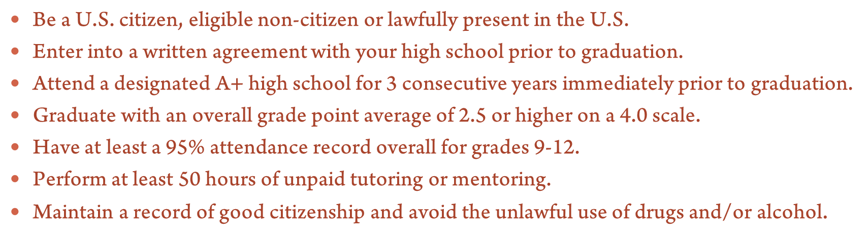

Notes:
‹#›

Slide 47
A+ Schools
Most common and closest- Ozarks Technical Community College and Crowder College
Missouri State University West Plains, Ranken Tech in STL
and State Technical in Linn, MO are FULL A+ tuition paid schools.
A+ is a MISSOURI program so it doesn’t help out of state
Did you know?? Most universities and some technical schools will give some kind of award of acknowledgment
Missouri State University- very few, but up to $2,000 total, must apply early
Drury University, Midwest Technical Institute, Missouri Welding Institute for example

Slide 48

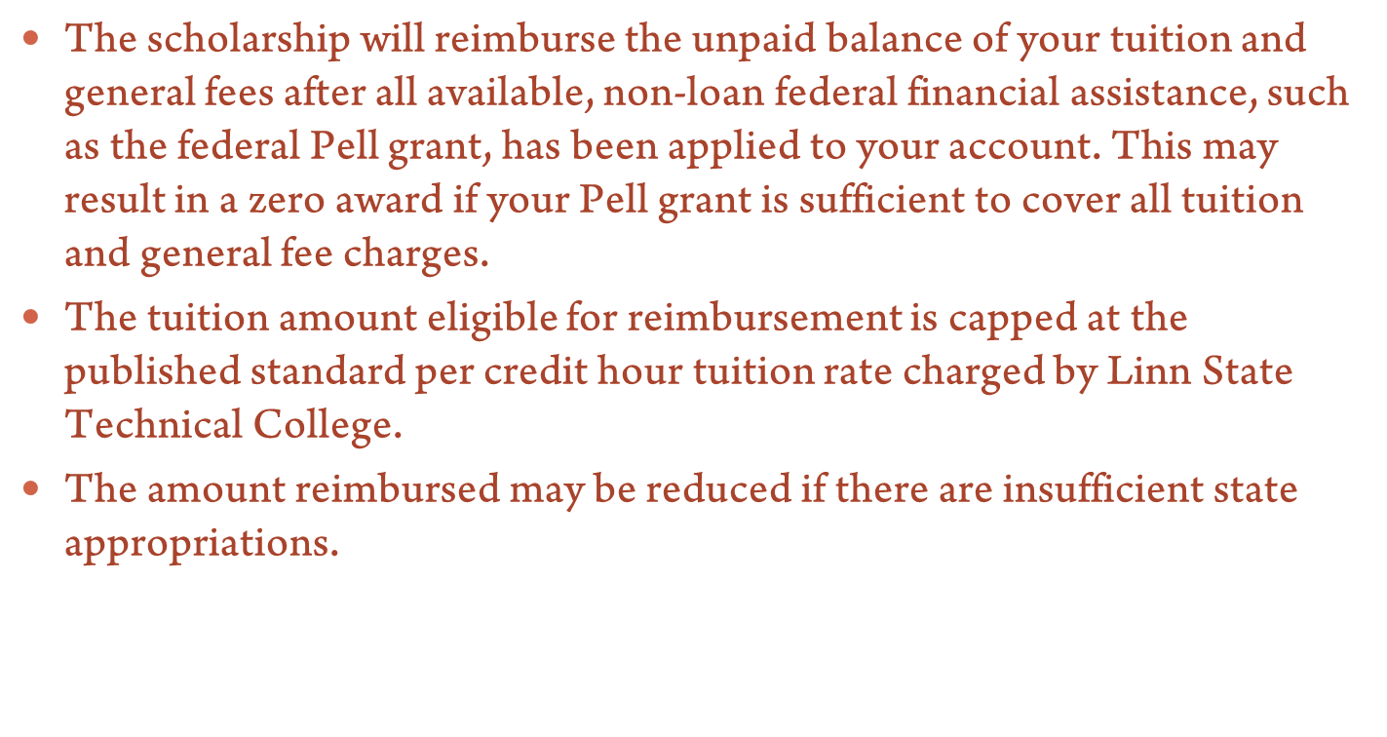

Notes:
‹#›

Slide 49

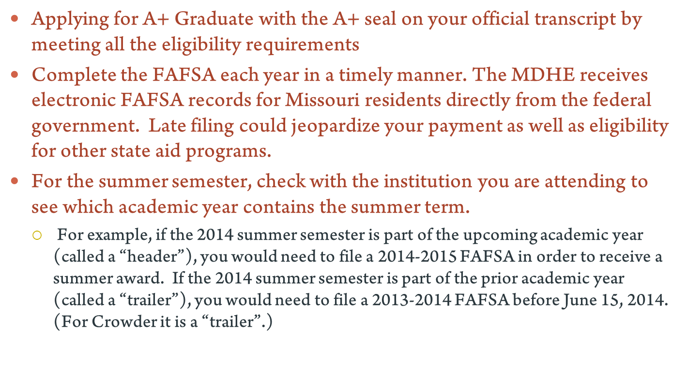
Notes:
‹#›

Slide 50
Receiving Financial Aid
Attend the FAFSA Frenzy Night - March 13
Sign up NOW for FAFSA ID number
*If A+ summer ‘15, must do FAFSA twice (2014-2015 school year & 2015-2016 school year)
Complete the FAFSA form after Jan 1 at www.fafsa.ed.gov --Applying for financial aid is FREE– DO NOT pay EVER
Want to know what your projected aid will be?
Log onto www.fafsa.ed.gov and click on “fafsa4caster”
Notes:
1. FAFSA4caster is found at bottom right under heading: Thinking About College

Slide 51
Financial Aid for College
New:
FAFSA ID now, instead of the FAFSA PIN #
You will have to create a username and password, keep these with your tax papers.
www.fafsa.ed.gov
NEVER pay for filing the FAFSA!!!

Slide 52

Financial Aid Websites
* www.collegeboard.com
* www.studentloan.com
* www.collegefundingco.com
* www.finaid.org
* www.fastweb.com
Notes:
‹#›

Slide 53

To Do List:
Create a master list or calendar that includes:
Tests you need to take, fees, and registration deadlines
College application due dates
Scholarship application due dates
Financial aid application forms required and deadline dates
College Rep days Wednesdays during Pirate time or 5th hour for Votech students
FAFSA Frenzy March 17 during P-T Conferences
Notes:
‹#›

Slide 54

To Do: August-September
Turn in Information sheet/Graduation agreement (TONIGHT) in yellow box on the table as you leave
www.actstudent.org (see handout)
Register for ACT if needed. This web site is full of excellent information for students and parents
Check your transcripts to make sure you have all the credits you need to get into colleges that interest you
Make a College Action plan
Where will you apply?
What might your degree be?
Notes:
‹#›

Slide 55
September-December
  Complete college applications
  Contact individuals for letters of recommendation, give 2 weeks notice, follow up
  Contact institutions about scholarship process
  Continue to work hard in classes
Notes:
‹#›

Slide 56
January-May
Receive letters of admittance, tell Mrs. Rabi!
Fill out FAFSA (general deadline is April 1, but check with each school, for CofO, everything must be done by Feb 15th)
https://fafsa.ed.gov/deadlines.htm#
Fill out local (Foundation application) and other scholarship applications
Make final decision about college choice
Post-secondary plans, contacts, etc. shared with CHS via Google docs or email
Notes:
‹#›

Slide 57
What to Expect
Fall (VERY BUSY)
  Applications, letter of recommendations, deadlines, testing
  Try to complete everything by Thanksgiving
Winter
  Look for Scholarships/Complete FAFSA for Financial Aid
  Make final decisions – apply for housing (depends on college),
Spring
  Make contact with chosen school
  Decline other offers
Summer
  Send final transcript
  Attend orientation
  PACK!
Notes:
‹#›

Slide 58

Notes:
‹#›

Slide 59

FAFSA Frenzy Night
Thursday, March 13
6pm-7:00pm (Students & Parents)
Bring Tax information (from Jan 1 2015 to Dec 31 2015)
(Start having conversations now with family with who will claim student each year (should be in divorce agreements or other legal documents)
I have a complicated situation….help??
  Set up an appointment with college financial aid person to insure accurate completion
Will need student and parent’s Social Security numbers and date of births and other info
Notes:
‹#›

Slide 60

Scholarships
Newsletters are emailed and mailed home
Scholarships posted online MrsRabi.Weebly.com
Crane Local Common Scholarships (one application that serves for all local scholarships)
Each college has their own scholarships
*Note application deadlines
Sign up for national scholarships through search engines like www.fastweb.com
Pro tip: set up separate email for scholarships
Notes:
Applying for scholarships is a full time job!
Scholarships normally are not just for freshman year

Slide 61
Scholarships
http://mrsrabi.weebly.com/scholarships.html
-Download my Scholarship Master list
-Register with the search engines
- NEVER PAY for someone to do scholarship searches for you
-Very rarely will it EVER cost to apply for a scholarship. General rule: It should never cost.

Slide 62
Laws of Scholarships
Always read the instructions!
APPLY- Apply- APPLY! (law of averages)
Set up a separate email
Save all your essays in the same place
Have someone else proof your essays ALWAYS
ASK around… ask everyone in your family about scholarships through their jobs or organizations. (ex: Walmart, American Legion)

Slide 63
Reminders
Parent information sheet leave on back table
Student information MUST be given by student to CHS before graduation
MrsRabi.Weebly.com
www.crane.k12.mo.us
      Our Schools
        Crane High
          Parents & Students
            High School Guidance Counselor’s Page

Slide 64
Reminders
  Tech Tips:
  -ACT Student (app or online)
  -ACT Photo (app)
  -ACT College Search (app)
  -Official ACT Question of the Day (app or online)
  -My Majors (app)
  -College FAFSA Finders
  Remind101, Schoolway, Facebook, email
Notes:
‹#›

